Slide 1

Large Language Models (LLMs) Workshop
Introduction and Hands-On Examples

Slide 2
Workshop procedure
…

Slide 3


Who am I?
EDUCATIONAL TRAINING
Sep 2015 – Sep 2018 Applied Statistics (M.Sc.), University of Göttingen
Sep 2012 – July 2015 Psychology (B.Sc.), Université de Fribourg (CH)
PROFESSIONAL TRAINING
Since April 2024 PostDoc Project in the DFG Research Training Group “Statistical Modeling in Psychology”, primary advisor Prof. Kiesel (University of Freiburg)
October 2020 – March 2024 PhD Project in the DFG Research Training Group “Statistical Modeling in Psychology”, primary advisor Prof. Kiesel (University of Freiburg)
Since Jan 2020 freelancer: coach for data analysis (supervision of bachelor, master and doctoral theses), private tuition on statistics

Slide 4
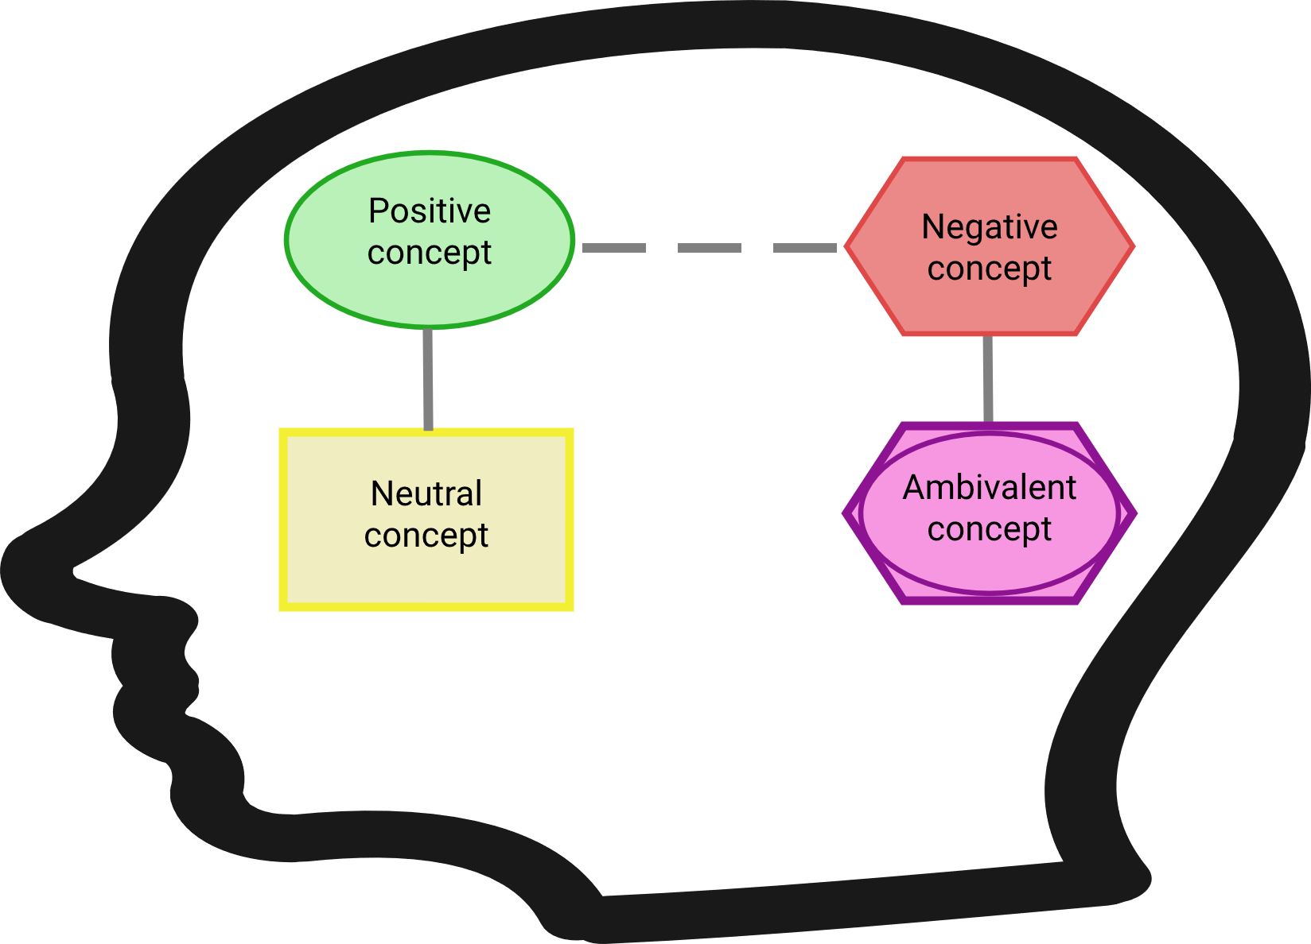
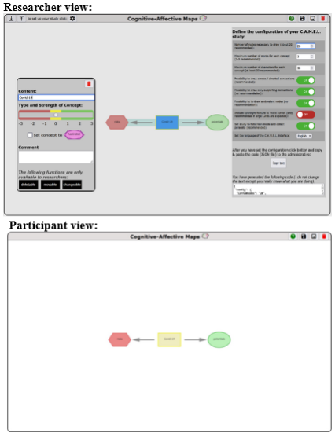
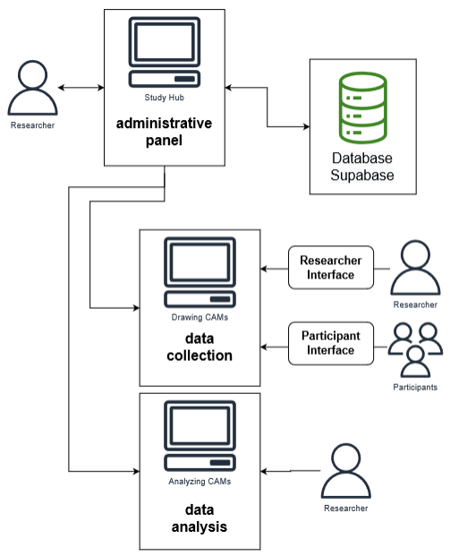
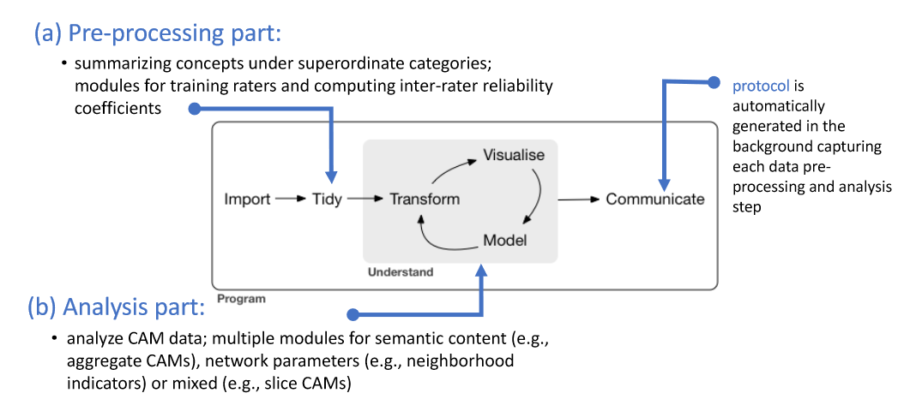
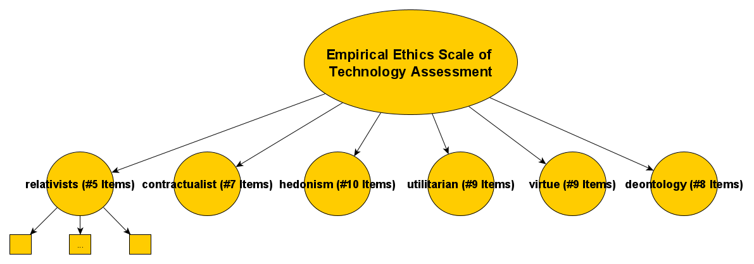
My research <-> LLMs
Semantic Networks: Cognitive-Affective Maps extended logic: Proposing Tools to Collect and Analyze Attitudes and Belief Systems
Empirical Ethics: Development and Validation of an Empirical Ethics Scale for Technology Assessment - Challenges and Perspectives for a Real Time Ethics for Emerging Technologies

Slide 5
Let’s start
How I felt while conducting the workshop:
https://i.giphy.com/media/v1.Y2lkPTc5MGI3NjExMG9teDM2NHRzZzZ3cnQwNHJnbGNlcWdjbTg2bTRoMjRpNDE2a3FxMCZlcD12MV9pbnRlcm5hbF9naWZfYnlfaWQmY3Q9Zw/s4tWF4aWrqgOUC00Kb/giphy.gif

